Slide 1
File I/0
Paula Hannan
hannanp@oit.edu
Last Updated: 1/16/2002

Slide 2
Objectives
For File I/O you should:
  Understand C++ file I/O
  Be able to describe C++ file I/O as an example of object orientation.
For 126 we will also discuss
  Advanced C++ file I/O – CST126 Topics

Slide 3
After this section you should be able to:
  Open a file and check for failure.
  Write or read from a file using >> or <<
  Write or read from file using the character functions.

Slide 4
I/O
Input and Output in C++ uses the idea of streams. A flow of characters into or out of your program.
We've seen user input and output streams with cin and cout. Now we'll do file I/O
cin and cout are in the header file <iostream>
File I/O is defined in the header file <fstream>
Without these header files C++ can input and output nothing, nada, zip. I/O is an add-on.

Slide 5
File Objects
Input files are objects of type ifstream.
Output files are objects of type ofstream.
You declare them like this:
  ifstream i_file;
  ifstream myFile;
  ofstream out_file;

Slide 6
File I/O
Then you can say things like:
  ifstream myFile;
  ofstream out_file;
  myFile.open("silly.txt");
  out_file.open("output.txt");
This is the external file name in
DOS land or Unix land or whatever.

Slide 7
File I/O
Once we declare and open the files we can use them just like cin and cout. For example:
  int var1;
  ifstream myFile;
  ofstream out_file("output.txt");
  myFile.open("silly.txt");
  myFile >> var1;
  out_file << var1;
The >> and << operators show
the direction of the stream.

Slide 8
File I/O
Of course when your done you'll want to close the file.
  ifstream myFile;
  myFile.open("silly.txt");
  myFile >> var1;
  myFile.close();

Slide 9
Sucess??
After an open you should test for failure using the istream member function fail. IE
  ifstream inFile;
  inFile.open("goober.txt");
  if (inFile.fail())
    cout << "Error opening goober.txt";
  else
    .....
fail() returns true if the open failed and false otherwise

Slide 10
>> and << with file I/O
Here is another example
ifstream inFile("blue.txt");
int blue;
if (!inFile.fail()) {
  while (!inFile.eof()) {
    inFile >> blue;
    cout << blue << endl;
  }
}
inFile.close();
What does this type of file i/o imply?

Slide 11
Opening a file on definition
You can also open a file on definition. For example:
  ifstream inFile("settings.txt");
This is the same as:
  ifstream inFile;
  inFile.open("settings.txt");
BTW, You should NOT do:
  ifstream inFile();
The compiler will think this is a function prototype for a function that returns ifstream and takes no input parameters.

Slide 12
User inputted file names
You can ask the user for the file name with the following code:
  char filename[50];
  cout << "Enter input file w/ extension : ";
  cin >> filename;
  input_file.open(filename);
This is a c-string or array
of characters that you will
study in 126.

Slide 13
Files and Functions
When you pass a file object into a function you MUST send it call by reference.
  Internally the object is keeping track of the last thing it read. It must be able to update this information and therefore it needs to be passed call by reference.

Slide 14
Example – Files and Functions
bool openFile(ofstream & oFile);
void outputFile(ofstream & oFile);
ofstream outFile;
if (openFile(outFile))
  outputFile(outFile);
outFile.close();

Slide 15
Output file open
The next slide is code for:
  bool openFile(ofstream & oFile);
Output files will automatically create the file if it doesn't exist. Sometimes we don't want this. The following function opens an output file without creating it.
Note: in <iostream.h> (But not <iostream>) there is a flag ios::nocreate that can be passed to the open function. Since we prefer <iostream> we won't use it.

Slide 16
bool openFile(ofstream & oFile) {
  ifstream temp;
  bool file_ok = false;
  temp.open("output.txt"); // Should cin file name
  if (temp.fail())
    cout << "output.txt doesn't exist";
  else {
    temp.close();
    oFile.open("output.txt");
    if (oFile.fail())
      cout << "Output file open failed";
    else
      file_ok = true;
  }
  return file_ok;
}

Slide 17
>> and << with file I/O
The << and >> operator exist for files and all native data times. Here is an output example:
ofstream outFile("dum.txt");
if (!outFile.fail()) {
  for (int i=0;i<20;i++)
    outFile << i;
}
outFile.close();
What do you think this produces?

Slide 18
Character I/O
The << and >> operator you've been using for user i/o get a whole variable until the user hits a return or a space.
So, what if you want the a user to enter:
  "first_name last_name"
The << operator won't deal handle it well.
So there are member functions of cin and cout to deal with this.

Slide 19
Input Character Member functions
For input streams: (ifstream files or cin)
  cin.get(char c); or c = cin.get();
    Get an character at a time
  inFile.getline(char * line, int length,char delim='\n')
    Get up to length characters from the input. If you don't pass in a delimiter assume that the input is delimited by a newline.
    There is also a version of getline for string objects

Slide 20
Example cin.getline
What will the following do if I always enter "Sally Sue"
char name[50];
cout << endl << "Enter your name ";
cin.getline(name,80);
cout << "Name is " << name << endl;
cout << "Enter your name ";
cin.getline(name,80, ' ');
cout << "Name is " << name << endl;

Slide 21
Sample cin.get
Frequently cin.get is used with loops:
  char c = ' ';
  cout << endl << "Enter your name ";
  do {
    c = cin.get();
    cout << c << c;
  } while (c != '\n');
When I enter paula h produces
  ppaauullaa hh

Slide 22
Output Member functions
For input streams: (ofstream files or cout)
  cout.put(char c);
    Puts a character to the output;

Slide 23
The Exit Statement
In <cstdlib>
Stops everything and exits immediately.
Convention says 1 = good 0 = failure.
We won't use in this class.
Exit is like a fire-alarm... you stop everything and get out of the building. Most failures are not that severe and you want to do some cleanup first.

Slide 24
I/O Objectives
By now you should be able to:
  Open a file and check for failure.
  Write or read from a file using >> or >>
  Write or read from file using the character functions.

Slide 25
Output Formatting
CST126 Students you should review output formatting at your leisure. The books explanation is good. Section 5.2 pages 241 -246 You should be able to:
  Use output stream formatting functions.
  Use manipulators from <iomanip>

Slide 26
Setf member function
Cout and files of type ostream can do a lot of formatting via the setf member function. We've already seen the magic formula:
  cout.setf(ios::fixed);
  cout.setf(ios::showpoint);
  cout.precision(2);
You could do the same for an output file:
  ostream oFile("output.txt");
  oFile.setf(ios::fixed);
  oFile.setf(ios::showpoint);
  oFile.precision(2);

Slide 27
More setf
There are many other formatting flags for setf. (See display 5.4 on 243) For example you can:
  Left Justfiy with
    cout.setf(ios::left);
  Use scientific notation with
    cout.setf(ios::scientific);

Slide 28
More Formatting
The variables like ios::showpoint are called flags. Hence setf means set-flag.
A flag is a signal to do things one of two ways.
There is also an unsetf member function to turn off the flags you set with setf. For example:
  Turn off left justification. (Go back to default which is right justify)
    cout.unsetf(ios::left);

Slide 29
IO Manipulators
Functions that manipulate output that are in <iomanip>.
Manipulators are placed after the insertion operator. (<<).
The one we will use is setw which determines what the width should be. For example;
  cout << setw(15) << 1 << "-" << 2 << endl;
  Produces:
  1-2

Slide 30
Formatting Review
Can you?
  Use output stream formatting functions.
  Use manipulators from <iomanip>

Slide 31
Object Orientation and Streams
Files in C++ are implemented as objects.
  ifstream myFile;
  Ifstream is a class and myFile is an object of class ifstream.
Cin and cout are also objects (of class istream and ostream)
What does this mean? Lets start with an example.

Slide 32
OO Objectives
In this section we will introduce object oriented programming using streams. You should be able to define and give an example of:
  classes, objects,
  base classes, super-classes or parent classes
  overloading, overriding, inheritance
  methods, encapsulation, messages, member data

Slide 33
First an OO Example
This example comes from the platypus book. “An Introduction to Object-Oriented Programming” by Tim Budd. 1991, Addison-Wesley
I want to send flowers to my Aunt Donna in Kansas City What do I do?

Slide 34
OO Example
I want to send flowers to my Aunt Donna in Kansas City What do I do?
    Call a florist with my Aunt’s address, the type of flowers to send and how much money I’m willing to spend.
    My florist then calls a florist in KC.
    The KC florist tells the arranger what kind of flowers to make.
    The KC florist sets up the delivery
    The KC florists orders more flowers to replenish their supply

Slide 35
OO Example
Each of the people in the example have information and procedures they do to get the job done.
In programming they would be considered an "object". An object is a construct with data and procedures or functions.

Slide 36
Messages
Objects do stuff by making requests of each other.
These requests are called messages. by passing messages
Just like in the florist example where each of the people make requests of each other with messages... either on the phone or a note or in person.

Slide 37
Inheritance – The classic Example
Animal
Mammal
Fish
Cats
Human
Tuna
Ziggy
Alicia
Mr. Limpet
Charlie

Slide 38
Inheritance
I know stuff about the florist because I know he is a florist which is-a shop keeper which is-a business.
For example because they are a shopkeeper I know that I probably can use my visa card to pay for it.
This is called inheritance.

Slide 39
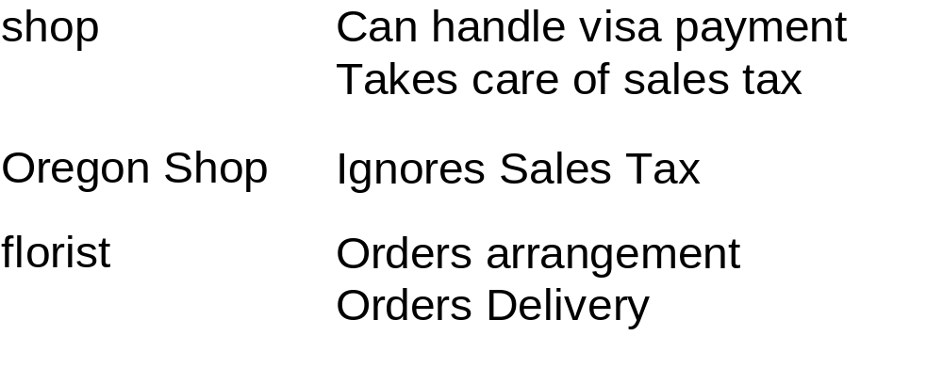
Example Inheritance
Here is the florist inheritance.
My florist is-a Oregon shop which is-a shop which is-a business etc.

Slide 40
Overloading and Overriding
In the example, an Oregon shop ignores sales tax. This is an example of an object overriding a method from its base class or parent class.
You could also consider this overloading. A function that has the same name that does something different based on the context.

Slide 41
My Definitions:
A class is a template and an object is a thing made from that template.
A function or operator that does something different based on the context is Overloaded.
Inheritance is the property by which objects gain access to data or methods of a previously defined class.

Slide 42
More Definitions
A method is a function for an object.
A base class, super-class or parent class: a class from which another class is derived.
Encapsulation - a 5 dollar word for contains. We say that an object encapsulates the methods and data needed to do its job.
A base classes methods and data can be overridden or given new meaning in a lower class.

Slide 43
Object Orientation and Streams
Methods are indicated in C++ with the . Operator and a ();
  myFile.close();
  output_file.close();
Close is a method of class ifstream and ofstream.
What object oriented concept(s) is having a close function on both objects an example of?

Slide 44
Inheritance and Streams
ios
istream
(reading)
ostream
(writing)
ifstream
(output files)
ofstream
(output files)
cin
cout

Slide 45
Object Orientation and Streams
Member data just with a . For example
  cout << florist.phone;
For good objects the member data is hidden from the programmer, so there isn't a really good example of member data with I/O streams.

Slide 46
OO Objectives
Can you define and give an example of:
  classes, objects,
  base classes, super-classes or parent classes
  overloading, overriding, inheritance
  methods, encapsulation, messages, member data

Slide 47
CST126 Advanced Stream Topics
We are going to cover the following:
  Other global stream objects
  Buffer flushing
  Stream states
  Open flags including opening a binary file
    How open flags related to bitwise operators.
Open up a blank c program and the slides so you can cut and paste from them.

Slide 48
Global Stream Objects
Turns out there are other stream objects then cin (like C stdin) and cout (like C stdout). They are:
cerr (of class ostream like cout). Normally this stream goes to the screen. Like C stderr. By default cerr is NOT buffered.
clog (of class ostream like cout) Also defaults to the screen. There is no C equivalent.
Tidbit of the day: There is also a wcin, wcout, wcerr and wclog for wide characters.

Slide 49
Global Stream Objects
You use cerr and clog the same way as cout. For example:
cout << "Hello world" << endl;
cerr << "The sky is falling" << endl;
clog << "The log is falling" << endl;
This would send the three lines to the screen.
In DOS land you can redirect cout to a file when you execute a program by using >:
  C:\> p_name > prog.txt
Does anyone remember how to redirect cerr?

Slide 50
Buffer Flushing
Some output is stored in a buffer before it is sent to output device. If something goes south it could still be in the buffer and never make it to the output device.
Clog is buffered. What do you think would print here?
  clog << "Hello world";
  double i = 0;
  double b = 5.0/i;
  clog << " Nice day ";
  clog << endl;
Try it and see.

Slide 51
Flush your buffers
To flush your buffers do one of the following:
  Endl – endln puts the '\n' then flushes.
  The manipulator flush() ie:
    clog << flush();
  The member function flush() ie
    clog.flush();

Slide 52
Buffers – A final note
In the versions of C that I worked on buffer flushing was a real problem.
If you ever get in the situation where you can't figure out why you aren't getting output first try flushing the buffers.

Slide 53
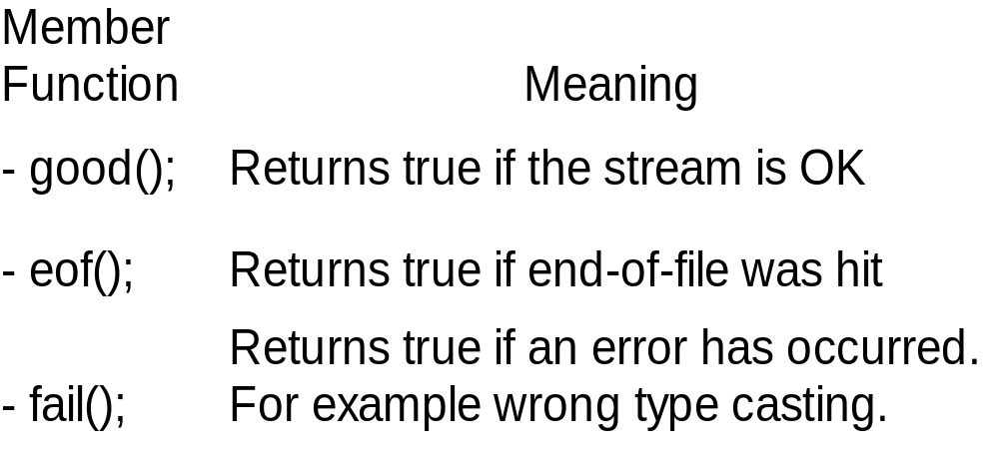
State of Streams
There are several member functions that help us know how our stream is doing. They are:

Slide 54
cin.fail();
Try this:
  int i;
  cout << "Enter a character";
  cin >> i;
  if (cin.fail())
    cout << " cin error " << endl;

Slide 55
Here's a gotcha for getline
Try this:
  char lng[30];
  cout << "Enter a long word" << endl;
  cin.getline(lng,5);
  if (cin.fail())
    cout << " cin error " << endl;
  cout << "Lng is " << lng << endl;
  cin.getline(lng,30);
  cout << "Lng is " << lng << endl;

Slide 56
Opening a binary file
To open a binary file you add an extra parameter:
ofile.open("name.bin", ios::binary);

Slide 57
I/O to a binary file
Since binary files have special characters you may not want to use getline or << and >>. You can use:
  write ( char * str, streamsize size );
  read ( char * str, streamsize size );
  ie
  ofile.write("blue",4)
Make sure the size is accurate or you may have unintended side-effects.

Slide 58
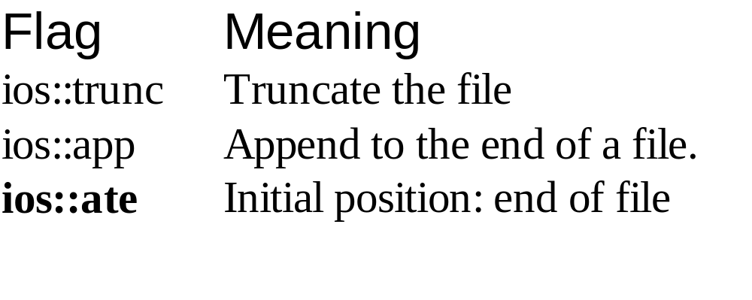
Bitwise Operators
There are lots of flags you can use when opening a file. For example:
So what would the following do? Why?
ostream f("b.bin", ios::trunc | ios::binary);

Slide 59
CST126 Advanced Stream Topics
Can you?
  Use and identify other global stream objects
  Describe how and why to Buffer flush
  Describe how to monitor Stream states
  Describe how to open a binary file?

Slide 60
Today's Index Card
For 5 points:
Front => Three important points from this class
Back =>
One thing you think I should review next time.

